Slide 1
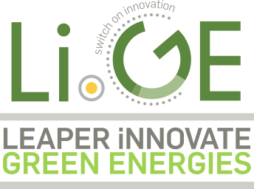
COMPRESSED AIR ENERGY STORAGE
LiGE “AIR BATTERY”
The Cleanest;
Most Innovative;
Most Cost Effective;
Energy Storage System;
That Produces Water.
The PERFECT Companion
to any Renewable Energy Installation
IN THE WORLD

Slide 2
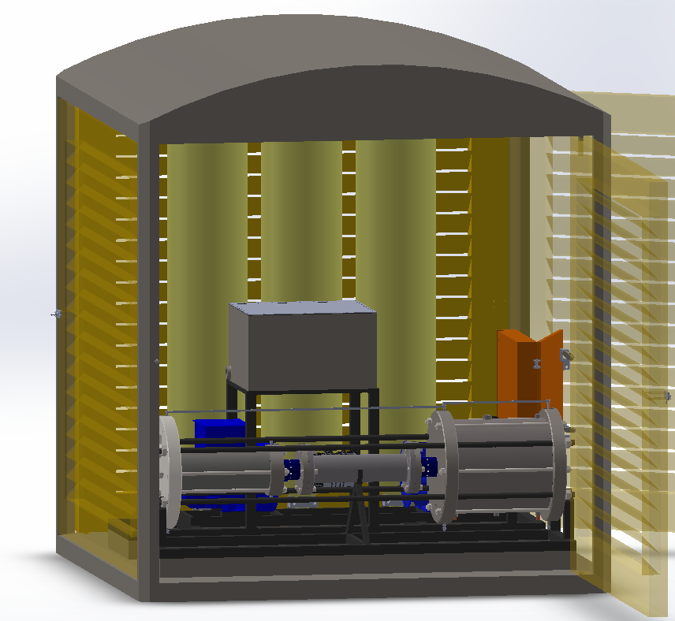

Medium and Large Energy users require a cost effective, stable power and water supply
LiGE designed, manufacture and supply Compressed Air Energy Storage Systems
“LiGE Air Battery” ™
Produces clean water as by-product;
Zero Carbon emissions;
30-year lifespan;
Cost effective;
An almost infinite storage life.

Slide 3
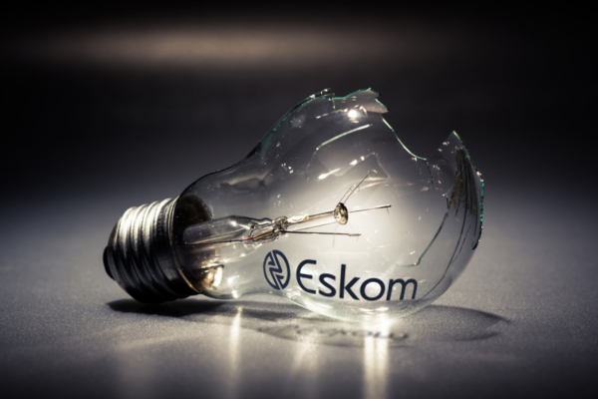
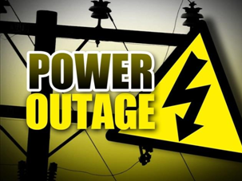
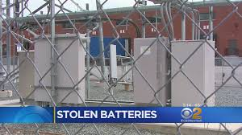
PROBLEM STATEMENT
Industrial / Commercial electricity users major pain:
Random interrupted electricity service delivery;
“in-production” power input costs rising;
Peak load management;
Solar PV requires storage;
Reluctance in the market to use battery storage.
Air Battery
Cell phone Towers major pain:
Battery Banks stolen every 2 weeks;
Battery Replacement Costs when stolen;
Battery Replacements Costs at end of life-span.

Slide 4
LiGE AIR BATTERY - CLEAN POWER
Our patented “Air Battery” converts energy from solar, wind and/or the grid, stores it as compressed air, creating electricity from the release of the stored compressed air;
Conventional deep cycle batteries that have to be replaced every 2-5 years or lithium 7-10 years;
The Air Battery does not contain any toxic chemicals;
The Air Battery does not deteriorate in performance during its entire 30-year lifespan.

Slide 5
LiGE AIR BATTERY - REDUCE ENERGY COSTS
65% saving on the CLIENT’S electricity bill
ROI 6.5 years *
Load levelling – Remove Peak demand charges
Peak Shaving
Low maintenance costs
Providing the same power performance levels for throughout its lifespan – 30 years
Saving up to 65% on electricity account! Whilst producing usable water!

Slide 6
LiGE AIR BATTERY – CLEAN WATER / AIR
Same power performance levels for 30 years
Produces Water through the process used
Cleaning the Air through the process used
Scalable from 40Kwh to 50Mwh storage system
As you are aware, there is 300 million billion
litres of water in the air at any given time!
When we compress air, we clean and dry the air!
The clean air is released back into the atmosphere!
The clean water is harvested and stored!

Slide 7
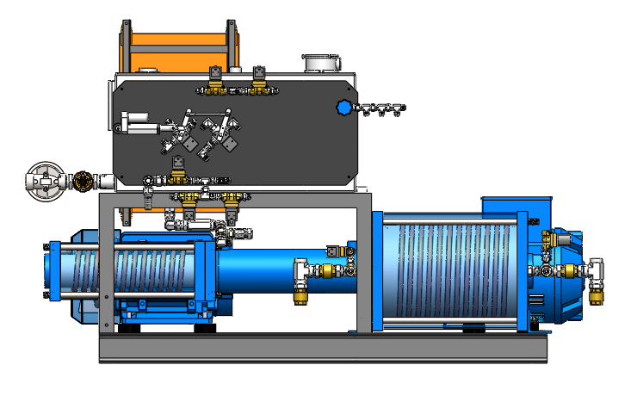
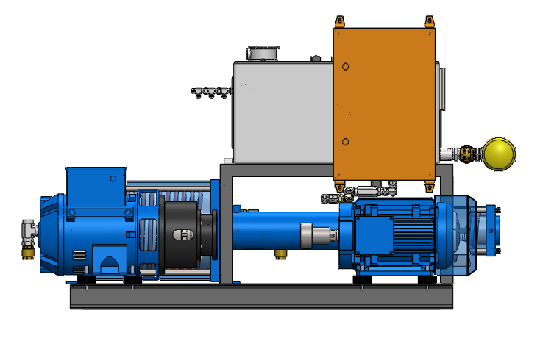
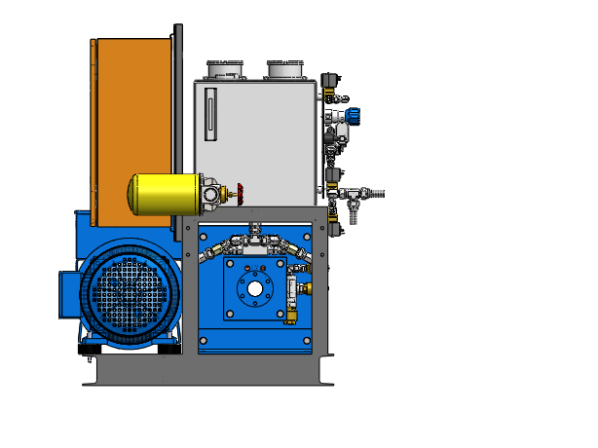
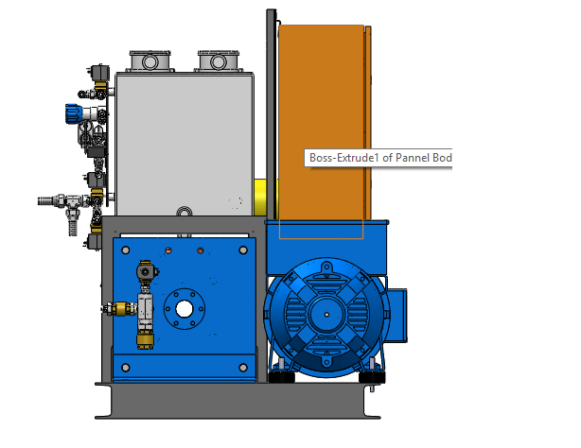
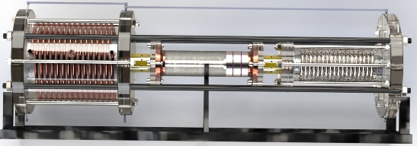
LiGE Patented Technology
Compressed Air
Driver System
Heat Energy Harvesting & Water Separation System

Slide 8
SUSTAINABILITY AND ENVIRONMENTAL IMPACT
Economic sustainability
Corporates are mandated by their shareholders to utilize cleaner energy
Environmental sustainability
Corporates to use renewables rather than carbon based products.
LiGE Air Battery:
Zero Carbon Emissions
Produce clean usable water
Cleaning the Air
Zero Rare Earth Metals used
Zero to Landfill all parts are RECYCLABLE

Slide 9
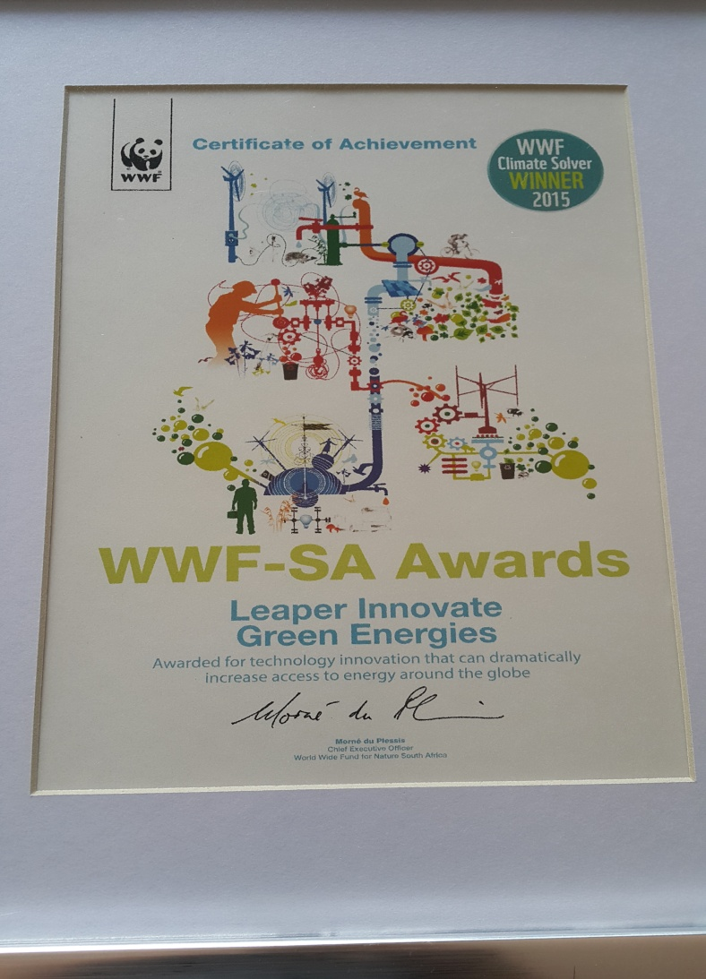

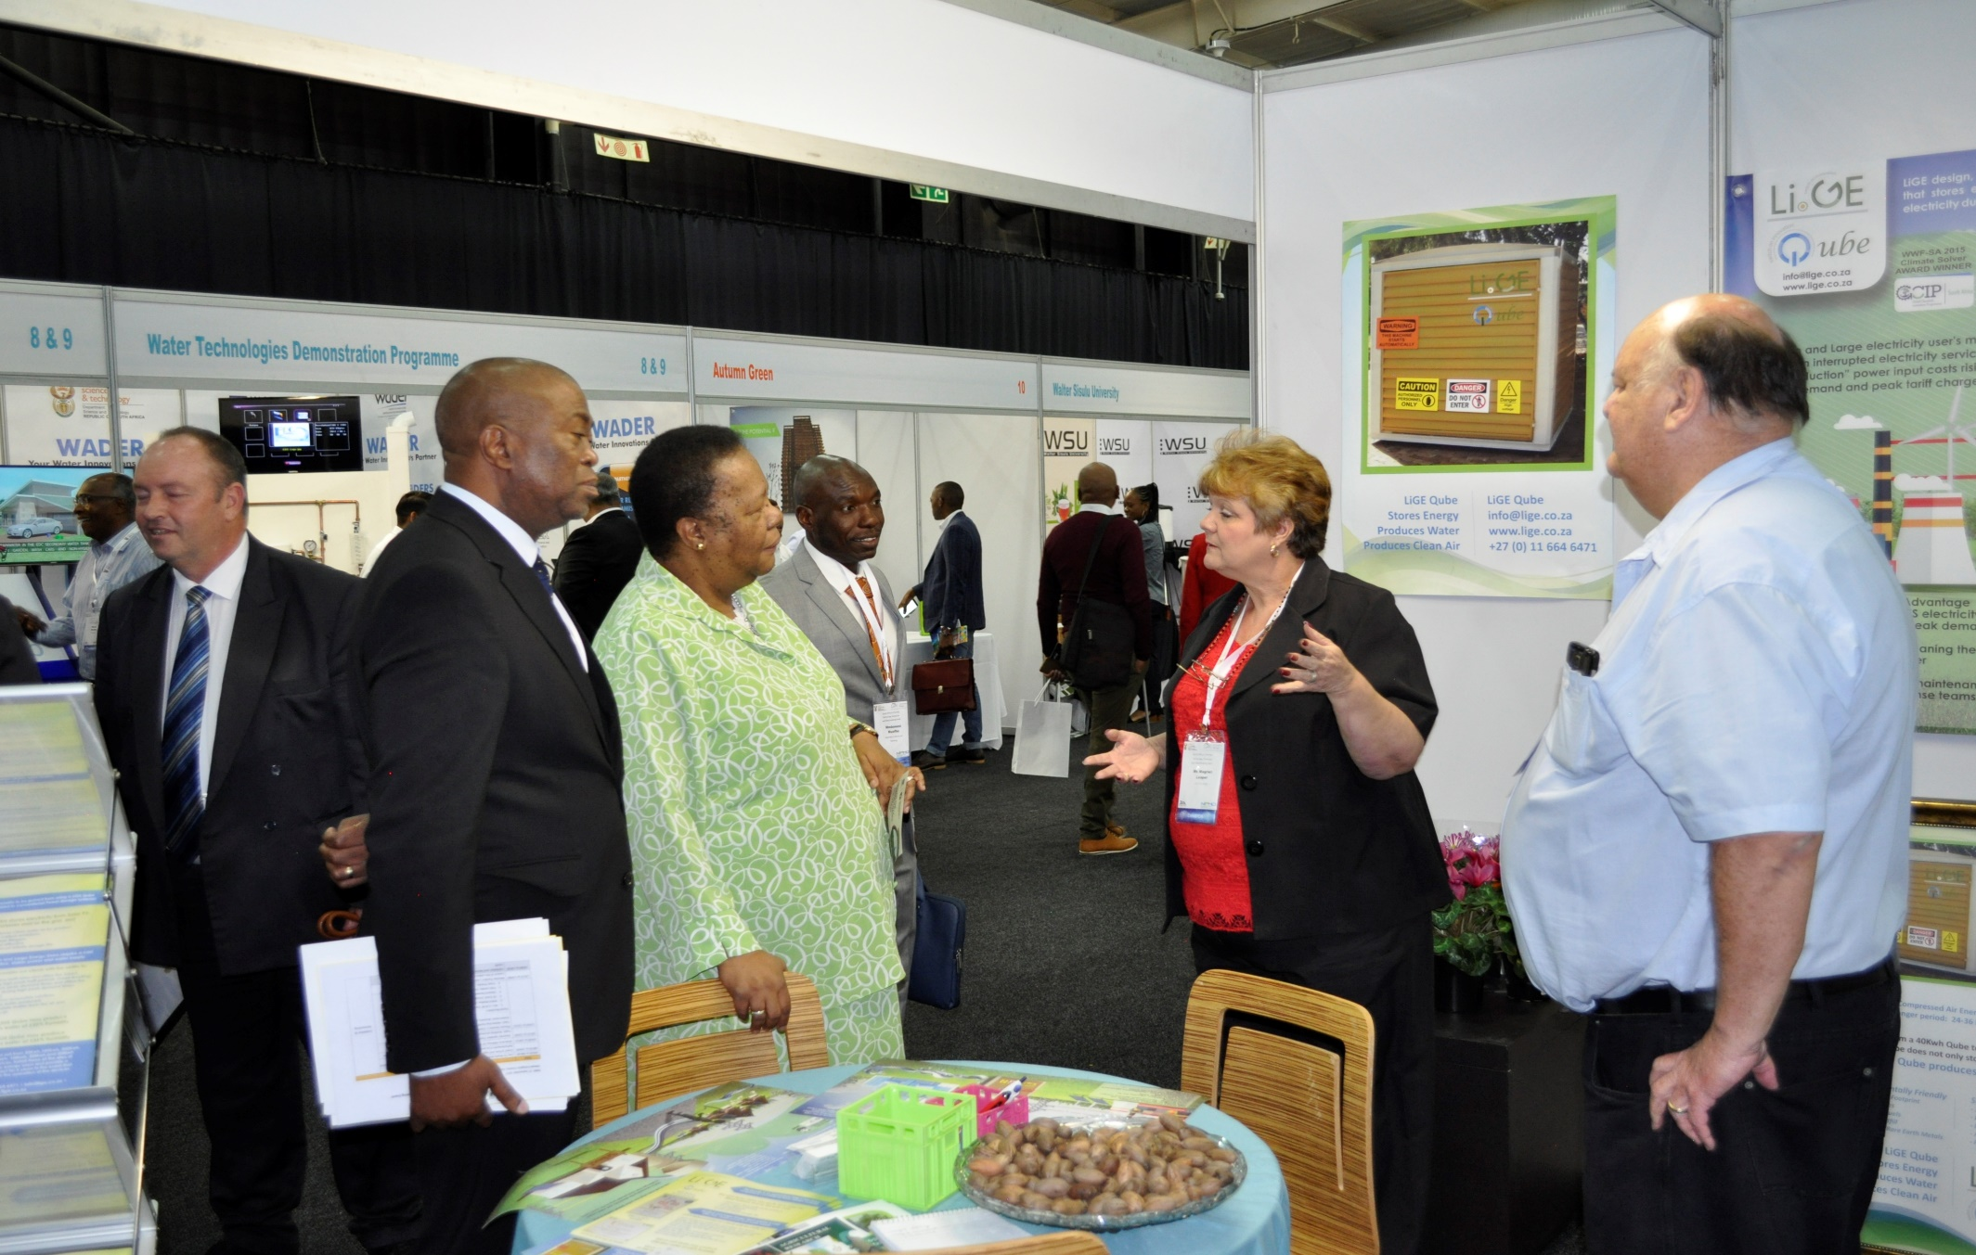

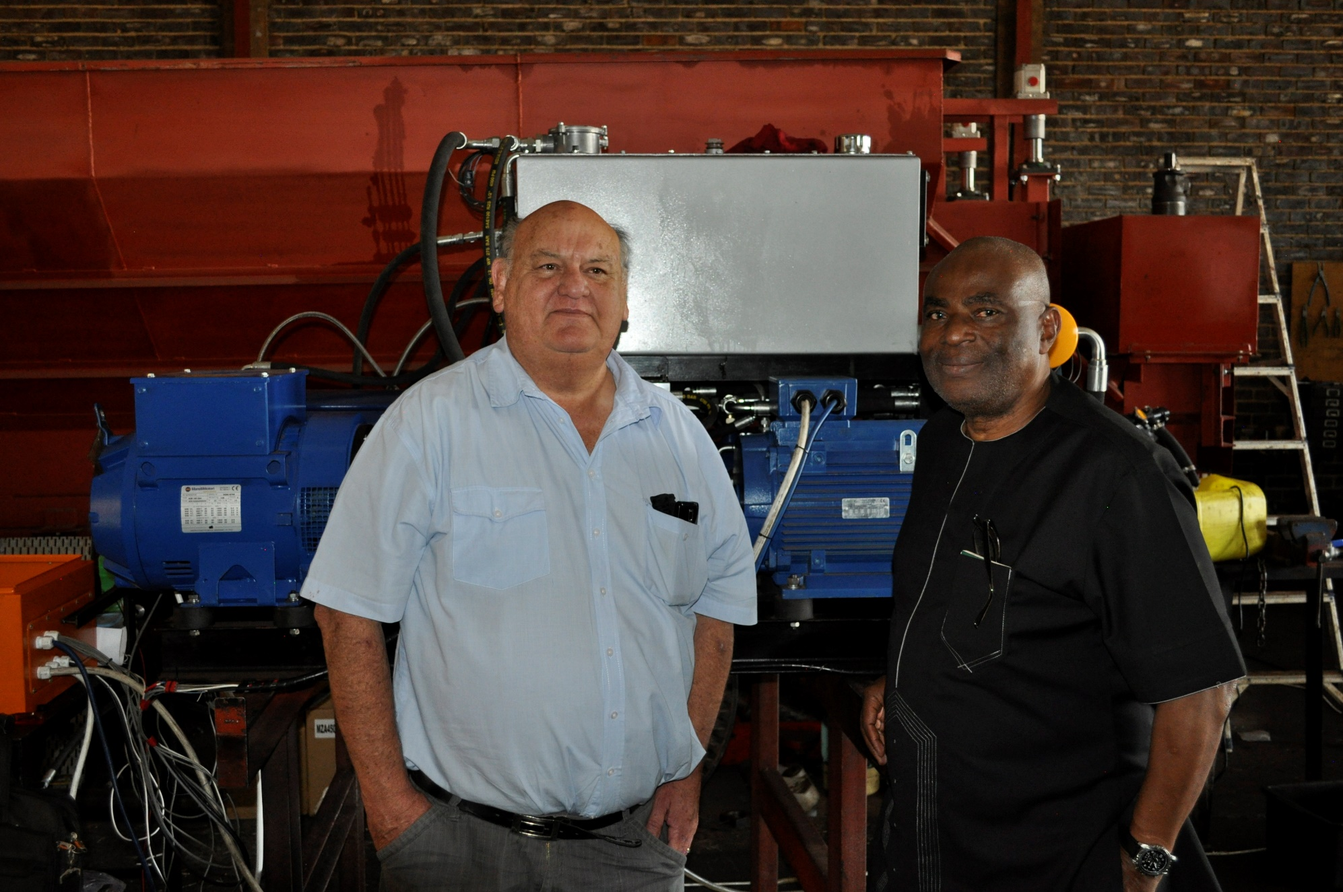



Achievements
LIGE AIR BATTERY – WINNER OF THE SOUTHERN AFRICAN STARTUP AWARDS 2019
Exhibiting at the Innovation Bridge
Minister Pandor at our stand
LiGE was one of the 15 finalists
chosen to pitch during the summit in Yekaterinburg – Russia
out of 200 entries worldwide.
(the only start-up in Africa )
9-11 July 2019
FINALISTS IN THESE AFRICA WIDE COMPETITIONS
Demonstrating to Nigerian Government Nov 2018

Slide 10
The LiGE team takes ownership of our customer’s pain by providing a suitable solution.
Current trends in energy supply and use are unsustainable:
Economically, Environmentally and Socially
so it’s time for us to make a difference
Al Karaki – karaki@lige.co.za
Warwick Leaper – warwick@lige.co.za
Magriet Leaper – magriet@lige.co.za
Ledimo Ndabezitha – ledimo@lige.co.za
www.lige.co.za
Contact our team for:
Partnership Agreements
Investment Opportunities
License Agreements

